Slide 1
Enterprise sales
Фишки 1 часть
Начинайте, всегда ожидая лучшего

Slide 2





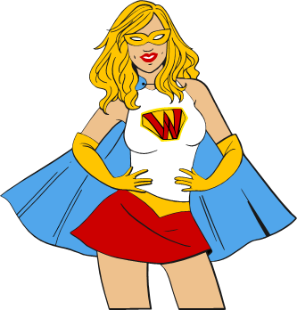

What's the plan?
Базовые потребности и DISC
Установление контакта
Диагностика
Презентация

Slide 3


Basic Needs
Комфорт
Новизна
Безопасность
Престиж
Экономия

Slide 4
DISC

Slide 5
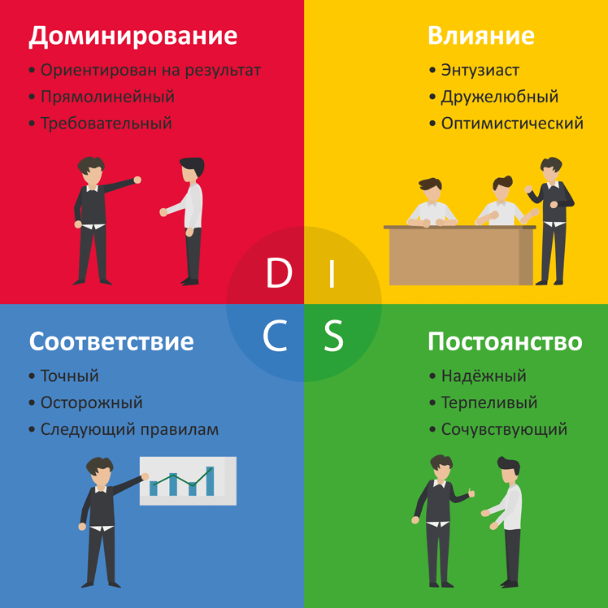
DisC

Slide 6

History and practice
Типология DISC впервые была сформулирована и опубликована в 1928 году, когда профессор Гарвардского университета Уильямом Малтоном Марстоном
Российские компании, применяющие Disc:
Биокад, Сбербанк Страхование, РЖД, Сапсан, Нефтьмагистраль, Гознак, Русская сталь, X-FIT,Техноград, Vestel, Холодильник.Ру, Медси, Бестдоктор, Убрир.
Сейчас более 80% компаний, входящих в Топ 500 используют эту методику на практике

Slide 7
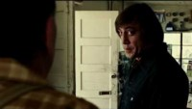
DISC

Slide 8
01
To set up a contact
Человек человеку — продавец, кассир, покупатель

Slide 9
There is a penetration
Открытые вопросы;
Эхо-прием
Маугли

Slide 10
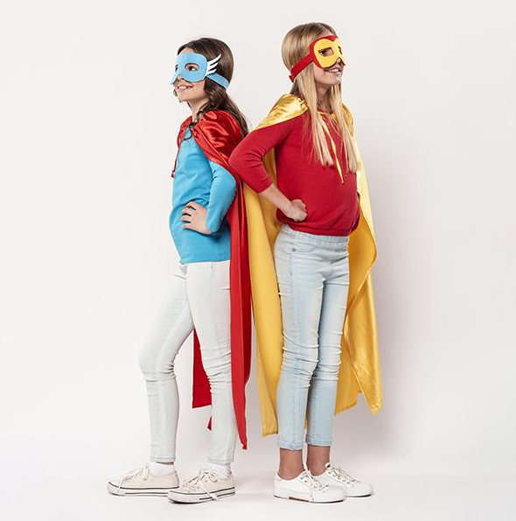
THE SLIDE TITLE GOES HERE!
Do you know what helps you make your point clear? Lists like this one:
They’re simple
You can organize your ideas clearly
You’ll never forget to buy milk!
And the most important thing: the audience won’t miss the point of your presentation

Slide 11
AWESOME HEROES!!

Slide 12
OUR HISTORY
Neptune is the farthest planet
Despite being red, Mars is a cold place
2000
2020
BOOM!!!!
1990
2010
2030
The Earth is the planet we live on
Saturn is composed of hydrogen
Mercury is the smallest planet

Slide 13
HEROES VS VILLAINS
Villains
Venus has a beautiful name, and it’s the second planet from the Sun
vs
Heroes
Mercury is the closest planet to the Sun and the smallest one

Slide 14
THREE SUPERPOWERS
Invisibility
Velocity
Strength
Venus has a beautiful name and is the second planet from the Sun
Despite being red, Mars is actually a cold place. It’s full of iron oxide dust
It’s the closest planet to the Sun and the smallest in the Solar System

Slide 15

A picture is worth a thousand words

Slide 16
HEROE COSTUME
Cap
Mask
Belt
Gloves
Despite being red, Mars is actually cold
Venus is the second planet from the Sun
Saturn is the only planet with rings
Jupiter is the biggest planet of them all

Slide 17
OUR WEAPONS
Ray
Explosive
Hammer
Missiles
Bullets
Bombs
Mercury is the smallest planet
Venus is the second planet from the Sun
Mars is actually a cold place
Jupiter is the biggest planet
Saturn is composed of hydrogen
Neptune is very far from the Sun

Slide 18
21 MILLION
Big numbers catch your audience’s attention
BOOM!!!!

Slide 19
ATTACKS
Heroes
Mercury is the smallest planet
Villains
Venus is the second planet from the Sun

Slide 20
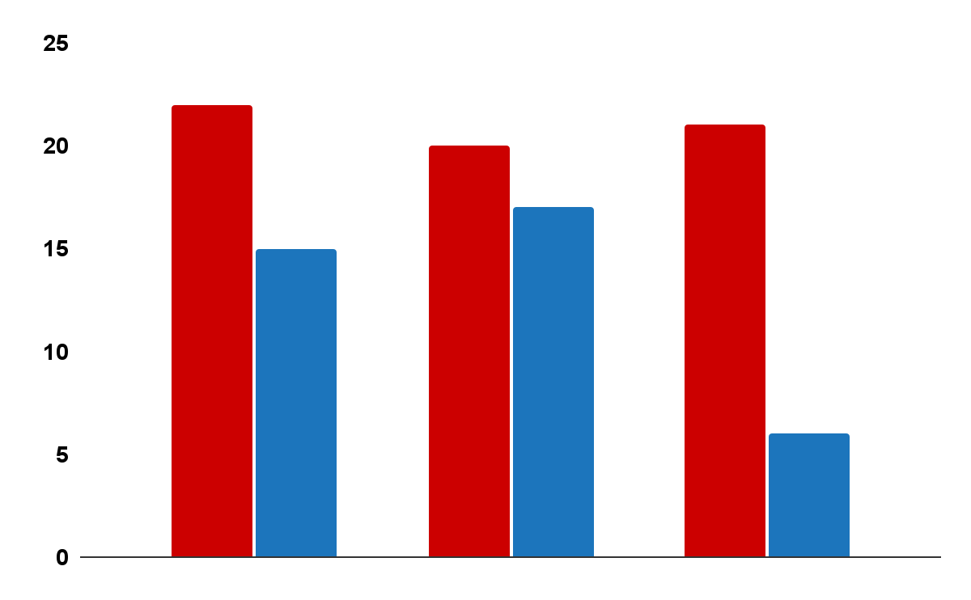
ENERGY POWERS
Heroes
Despite being red, Mars is actually cold
Villains
2019
2020
2021
Neptune is very far from the Sun
Follow the link in the graph to modify its data and then paste the new one here. For more info, click here

Slide 21
333,000,000
386,000 KM
Earths is the Sun’s mass
Is the distance between the Earth and the Moon

Slide 22
EPIC BATTLES
Year | Heroes | Villains
2010
2012
2015
2020
Victory
Despite being red, Mars is very cold
Defeat
Neptune is very far away from the Sun

Slide 23
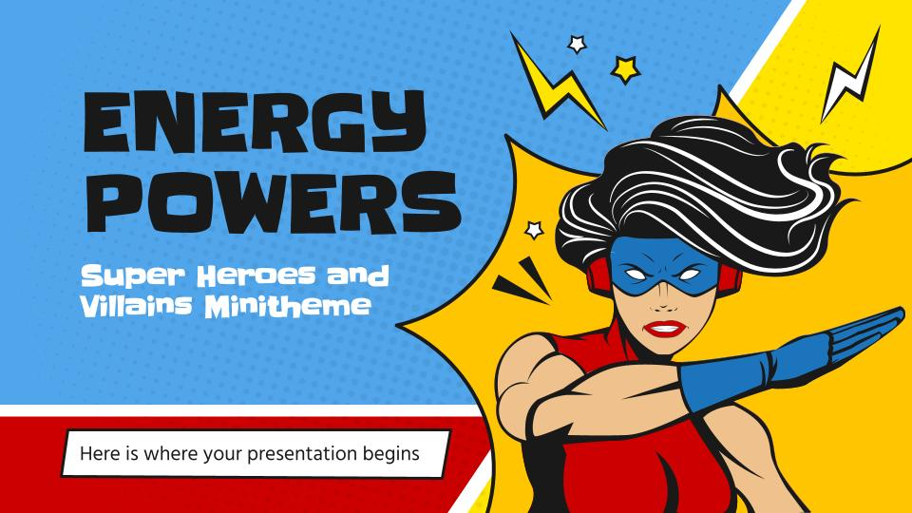
PRODUCT DEMO
You can replace the image on the screen with your own work. Just right-click on it and select “Replace image”
B OM

Slide 24
THANKS!
Do you have any questions?
youremail@freepik.com
+91 620 421 838
yourcompany.com
Please keep this slide for attribution

Slide 25
SUPERHERO ICON PACK

Slide 26
ALTERNATIVE RESOURCES
Here’s an assortment of alternative resources whose style fits the one of this template
Photos:
Side view asian superhero in flying pose
Bang comic text sound effect speech bubble in retro pop style art
Vectors:
Comic speech bubbles background

Slide 27
RESOURCES
Here’s an assortment of alternative resources whose style fits the one of this template
Photos:
Young girls wearing superhero costume
Girls with mask and costume of heroes
Vector:
Comic instagram stories
Halftone female superhero background
Set of comic items in flat style
Pack of scary hand drawn halloween characters
Set of comic sound effects
Cartoon robyn card
Superheroine character with pop art style
Variety of comic elements
Flat comic style background
Comics wallpaper with speech bubble
Flat comic style background
Icon Pack:
Icon pack Superhero
BANG!

